Slide 1
History of the Web Part Two: Modern Web Development

Slide 2
Raymond McDermott Lead Software Engineer & University Liaison feature[23]
Original degree in Music (Classical Guitar) from Florida State
Degree that makes money (Computing) from UNF
Musician, martial artist, home brewer, and USCG certified (expired) captain

Slide 3
Why?
Notes:
Why are we here today?
Our goal is to deliver these lectures in a Socratic fashion.
We’ll ask the questions we most frequently hear from students, and try to shape the lectures as the answers.
We’ll start today with Front End Web Development and move toward the server, database, and beyond as the weeks progress, eventually piecing everything together.
How does the Web work (at a high level)?
What do I need to know to start working as a Web Developer?

Slide 4
User Interface Design
User Experience Design/Engineering
Mobile
Software
Hardware
Networking
Security
Database Management
SQL/NoSQL
Big Data
Data Warehousing
Data Mining
Software Consulting
Client Management
Project Management
Process Management
Web
Notes:
Just to give you an idea of the current scope of the field and all there is to know…
This is a very high level overview and I’m probably leaving out 20 more
Today we’re just looking at the Web piece, again, at a very high level
This is not here to freak you out, but more to illustrate that there’s a ton to learn and hopefully today’s talk will motivate you to start tackling these topics sooner than later. You might find that your passion lies in Data, not in Software.

Slide 5
HTTP
Notes:
So, let’s start where the Web starts, at least from the Client’s perspective.
Of course there’s plenty of other Networking concepts, underpinnings of the browser and such, but for all intents and purposes, this is where we should start for basic Web Development.

Slide 6
HTTP is the foundation of data communication for the Internet
Hypertext is structured text that uses logical links (hyperlinks) between nodes containing text
HTTP functions as a Request-Response protocol for the Client-Server computing model
Origins in Packet Switching
Notes:
The first version of the protocol had only one method, namely GET, which would request a page from a server.
HTTP v 1.0 1996
To give an idea of how slow things progress:
2007, new Working Group created to revise HTTP 1.1 (1999), released RFC (Request for Comments) 2616 in 2014
HTTP 2 published in May 2015

Slide 7
HTTP Verbs

Slide 8
GET
POST
PUT
DELETE
HEAD
TRACE, OPTIONS, CONNECT, PATCH
Notes:
GET, POST, PUT, and DELETE correspond to CRUD
HEAD is identical to GET, but returns no body. Good for checking if a file exists or if a URL is serviceable.
PATCH is a partial update (PUT is more resource heavy, entire entity)
Idempotence
Same request should produce the same result no matter how many times it is called
PUT and DELETE should be idempotent, meaning that multiple identical requests should have the same effect as a single request

Slide 9
Status Codes

Slide 10
Informational 1XX
Successful 2XX
Redirection 3XX
Client Error 4XX
Server Error 5XX
http://www.restapitutorial.com/httpstatuscodes.html
Notes:
HTTP Response Codes indicate whether a specific HTTP requests has been successfully completed. Responses are grouped in five classes: informational responses, successful responses, redirections, client errors, and servers errors.

Slide 11
HTTP Session State
Notes:
HTTP is a stateless protocol
You can leverage cookies or hidden variables to track the User's state Server side

Slide 12
HTTPS

Slide 13
Uses either TLS or SSL
Averts “Man-in-the-middle” attacks
Certificate Authorities
Public/Private Keys

Slide 14
Requests

Slide 15
Request Line: GET /resources/someImage.jpg HTTP/1.1
Request Header Fields
Empty Line
Request Body (Optional)

Slide 16
Responses

Slide 17
Status line includes the Status Code and Reason Message: HTTP/1.1 200 OK
Response Header Fields
Empty Line
Message Body (optional)

Slide 18
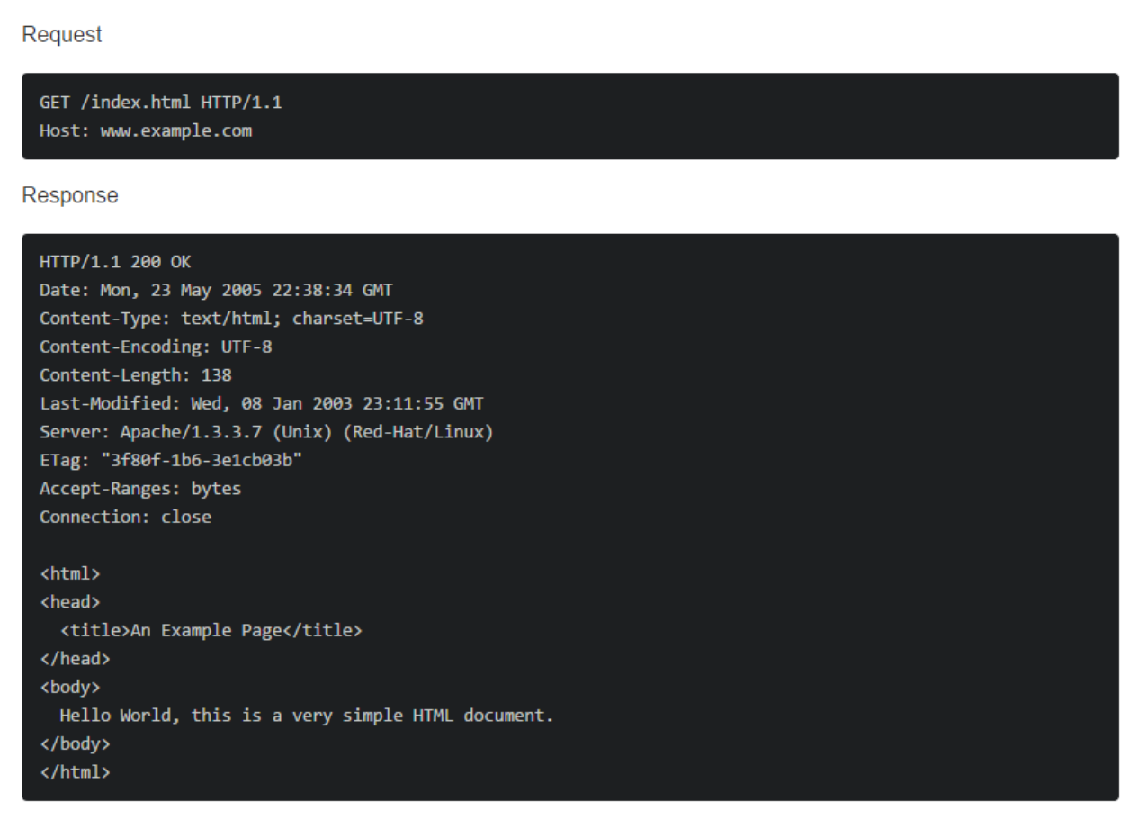
Notes:
http://jsonplaceholder.typicode.com/
POSTMAN

Slide 19
HTML

Slide 20
Hyper Text Markup Language
Describes the content of the page, giving the page structure
The Internet was originally about scientists sharing Documents
Uses semantically named element tags to give meaning and context to the Document
http://www.w3schools.com/tags/
Notes:
A markup language is a language that annotates text so that the computer can manipulate it for some purpose.
DOM
Html, head, body
http://www.w3schools.com/tags/

Slide 21
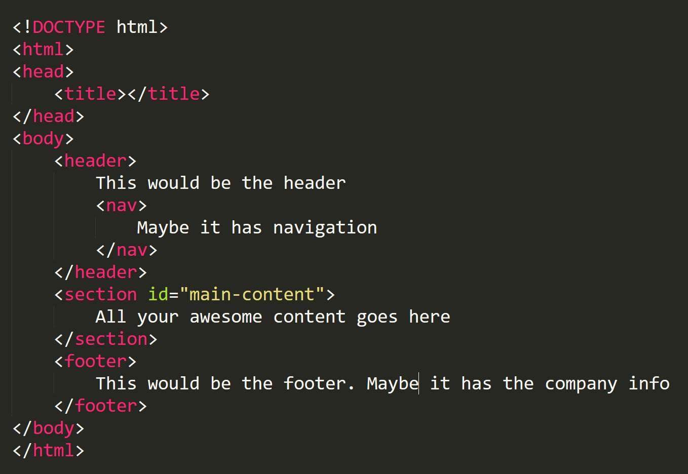
Notes:
This covers Layout and Structure, but what about style?

Slide 22
HTML Forms
Notes:
http://www.w3schools.com/html/html_forms.asp

Slide 23
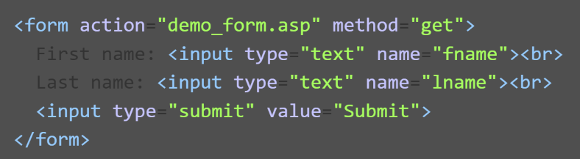

Slide 24
Notes:
Separation of Concerns
https://en.wikipedia.org/wiki/Separation_of_concerns
Cascading Shit Storm

Slide 25
Separates the responsibility of styling elements and general presentation concerns outside of the page’s structure
Is a declarative language
Can be painful if you don’t take the time to understand it
CSS is basically a set of rules that tell the elements on the page what they should look like
en.wikipedia.org/wiki/Separation_of_concerns
Notes:
HTML is mainly used for organization of webpage content, CSS is used for definition of content presentation style, and JS defines how the content interacts and behaves with the user. Historically, this was not the case: prior to the introduction of CSS, HTML performed both duties of defining semantics and style.

Slide 26
CSS Selectors

Slide 27

ID Selector

Slide 28

Class Selector

Slide 29

Element Selector

Slide 30

Child Selector

Slide 31

Pseudo Selector

Slide 32
Box Model
Notes:
Demo in JS Fiddle

Slide 33
Positioning

Slide 34
Static: an element’s normal place in the DOM
Fixed: the elements are measured against the browser’s frame and don’t move
Relative: the element will be measured against what its static position would be
Absolute: Same as relative, but positioned relative to the first parent element that has a position other than static. If there isn’t one, it defaults to the HTML tag. They live outside the regular flow of the HTML document.
Notes:
Static is the default positioning value for the css position property. The static value simply tells the browser to position this element in the “normal flow” of the document.
Fixed positioning is measured against the frame of the browser window. Elements with a fixed position value do not move even when the contents of the browser window are scrolled. The navigation bar at the top of this page uses the fixed position value so it is always visible. Because fixed elements are outside the flow of the document they can sometimes cause unexpected results that you have to deal with carefully.
A relatively positioned element is measured relative to its normal position in the flow. Using a relative position value lets you create elements that overlap each other.
An absolute element is positioned relative to the first parent element that has a position other than static. If no such element is found, the containing block is the html tag for the entire document. Absolutely positioned elements are positioned outside the normal flow of the document.

Slide 35
JavaScript
Notes:
https://en.wikipedia.org/wiki/JavaScript

Slide 36
JavaScript was created in 10 days in May of 1995 by Brendan Eich while at Netscape
It needed to “look like Java” with a C-like syntax
Purpose was to enhance behaviors on the client-side and create a more dynamic user experience
Today, JavaScript is everywhere… for better or worse
Notes:
Java is to JavaScript as Car is to carpet
JavaScript is prototype-based with first-class functions, making it a multi-paradigm language, supporting object-oriented,^{[8]} imperative, and functional programming styles
The most common use of JavaScript is to add client-side behavior to HTML pages, a.k.a. Dynamic HTML (DHTML). Scripts are embedded in or included from HTML pages and interact with the Document Object Model (DOM) of the page. Some simple examples of this usage are:
Loading new page content or submitting data to the server via AJAX without reloading the page (for example, a social network might allow the user to post status updates without leaving the page)
Animation of page elements, fading them in and out, resizing them, moving them, etc.
Interactive content, for example games, and playing audio and video
Validating input values of a Web form to make sure that they are acceptable before being submitted to the server.
Transmitting information about the user's reading habits and browsing activities to various websites. Web pages frequently do this for Web analytics, ad tracking, personalization or other purposes.^{[60]}

Slide 37
AJAX
Notes:
AJAX stands for Asynchronous JavaScript and XML. In a nutshell, it is the use of the XMLHttpRequest object to communicate with server-side scripts. It can send as well as receive information in a variety of formats, including JSON, XML, HTML, and even text files
http://youmightnotneedjquery.com/
The point here is better user experience, not as jarring of a UI to refresh the entire page.

Slide 38
Questions?

Slide 39
General
http://interactivepython.org/runestone/static/webfundamentals/index.html
https://developers.google.com/web/
https://ruslanspivak.com/lsbaws-part1/
https://www.petekeen.net/dns-the-good-parts
JavaScript
http://davidshariff.com/quiz/
http://jsonplaceholder.typicode.com/
https://javascriptweblog.wordpress.com/2010/10/25/understanding-javascript-closures/
https://github.com/stevekwan/best-practices/blob/master/javascript/gotchas.md
http://youmightnotneedjquery.com/
Design Patterns
https://addyosmani.com/resources/essentialjsdesignpatterns/book/
http://shop.oreilly.com/product/9780596007126.do

